Slide 1
Packet Filtering in SDNs Using Machine Learning
Sai Harsha Kotapalli (cs17btech11036)
Shraiysh Vaishay (cs17btech11050)
Puneet Mangla (cs17btech11029)
Desu Surya Sai Teja (cs17btech11048)
Sagar Jain (cs17btech11034)
Lingam Sai Ramana Reddy (cs17btech11022)
Chander Shekhar (cs17btech11011)
Bhavya Bagla (cs17btech11007)

Slide 2
Summary of The Project
Given a filter, only traffic deemed legitimate by this filter will be allowed.
Can avoid incoming traffic from websites hosting unwanted content with a domain name which cannot does not indicate the same.
Motivation: The current firewalls can easily be fooled, for example using content spoofing. Rules for dropping packets from website with a good domain name but hosting unwanted data, is rather difficult to set in traditional firewalls.
We aim to solve this problem using SDNs and ML.
Novelty: Combining concepts of Firewall, SDNs and ML into one. To our best knowledge not done so far.
Papers/Blogs/Sources:
https://www.hindawi.com/journals/misy/2018/6462826/
https://networkingnerd.net/2014/09/23/sdn-use-case-content-filtering/
https://arxiv.org/pdf/1811.00634.pdf
As we show in our video demonstration, we have a complete end-to-end working pipeline, tested on several websites offering features like blocking using keywords, regexs, handling intranet websites etc.

Slide 3
Overall Architecture
Since our project is based on SDN, we have the following stakeholders in our system:
The client, who makes a request for a particular url
The SDN which handles the request
Requests go from client to SDN and the response based on the logic within the SDN is sent back to the client.
The following slide contains the communication details of the system.

Slide 4
Packet arrives, send it to SDN controller
Extract domain name from packet
Parse website and extract keywords
IP: XXX.XXX.XXX.XXX
www.tpbproxypirate.com
['proxy','pirate',
'torrent’]
75%
similar
Forwards the packet
Similarity Metric
Use ML to find similarity
Filters provided
> 70%
['proxy','piracy','torrent','download']
Drop it

Slide 5
System Block Diagram : SDN Controller
_packet_in_handler(event) : Whenever a new TCP/UDP packet arrives, calls isReliable() to decide whether to add a forward entry or drop entry to the flow table
isReliable(src, dst, raw_pkt) : calls checkNewEntry() to update rules or check if already processed before. Returns if good site or bad site after checking rules/ function calls.
checkNewEntry(pkt)
calls get_hostname_ip_from_pkt() to retrieve hostname and ip address. Ignore if packet’s hostname is empty
Check if the hostname is already in the processed list. If so, associated rule already exists. Otherwise extract keywords and use ML model as explained in subsequent slides.
get_hostname_ip_from_pkt(pkt)
Maintains a list of authorized dns servers.
Uses Scapy to parse the packet and checks if the given packet is a DNS reply. If so, returns the server name and the associated IP address else empty strings
DNS Packet (SDN)
Extract domain name

Slide 6
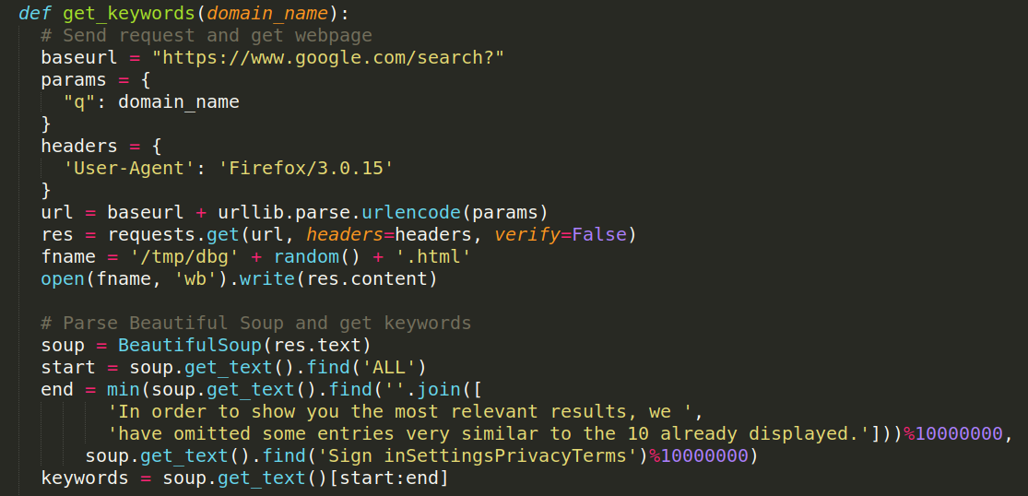
System Block Diagram : Getting keywords
DNS Packet (SDN)
Look up on the web (google search)
Extract domain name
Parse it using Beautiful Soup
Get keywords

Slide 7
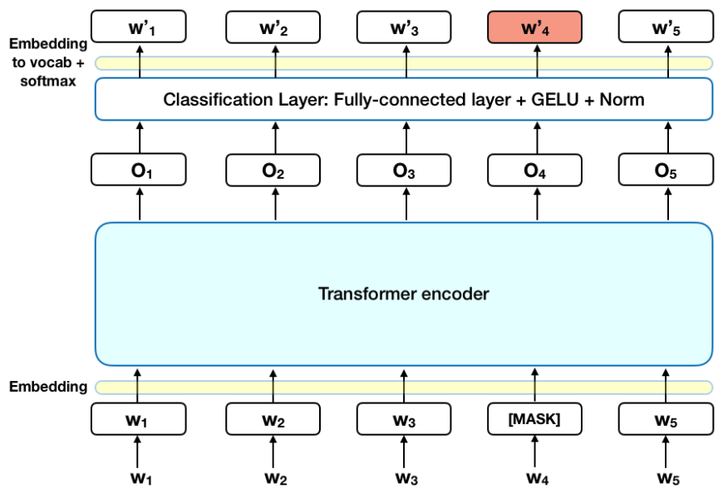
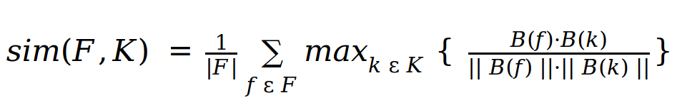
System Block Diagram : Similarity using BERT
def preprocess(keywords):
To Lower, remove punctuation, remove stopwords, Most frequent words
Look up on the web (google search)
Preprocess
BERT
Embeddings
Parse it using Beautiful Soup
Similarity
Get keywords
def similarity_check(keywords,filters):

Slide 8
Features added/tested after mid-evaluation
Handling Intranet websites.
Blocking packets using additional info like subnet.
Minor bug fixes while handling multiple requests, invalid websites.
Handling dns entries with multiple records for ip address for a hostname.
Added Timeout to flow entries to stay updated. (disabled in demo as the environment is slow)
Time Efficient: We tried with different BERT architectures proposed recently like BASE BERT, LARGE BERT, RoBERTa and DistilBERT. Finally we opted for DistillBERT because it is smaller, faster and lighter. It makes processing slightly faster and doesn’t cause any memory issues unlike BASE BERT used earlier.
Corpuses of BERT: Finally we used Wikipedia’s uncased dataset as it is shown to train BERT models efficiently.

Slide 9
System Implementation
Operating System = Ubuntu 18.04
Programming Language = Python3
APIs = beautifulsoup, bert embeddings, ryu, scapy
Platform = Mininet / OpenFlow13.

Slide 10
Explanation of Video-based Demonstration
What do you show in the demo?
We successfully block “bad” websites and allow “good” websites.
What is the network topology?
A switch connected to three hosts.
A Controller connected to the switch
Switch connected to the internet via NAT.
SDN cont.
Host 1
Host 3
Internet
OVS
NAT
Host 2

Slide 11

.

Slide 12
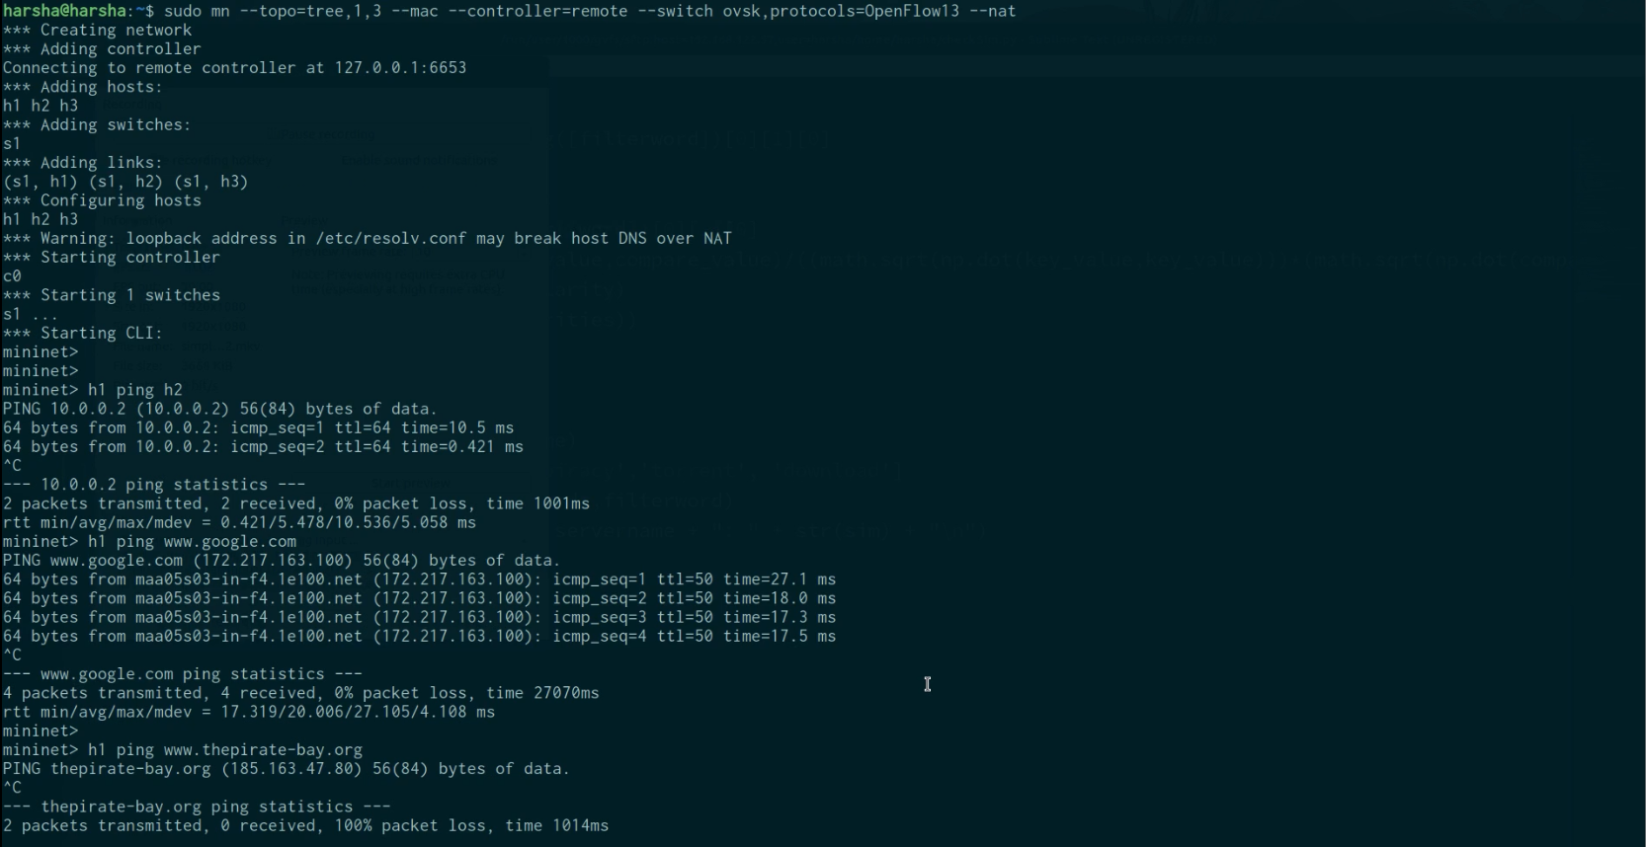
Network Configuration
Internet subnet. Doesn’t block
Pinging google. Doesn’t block
Pinging
Piratebay. Blocked

Slide 13
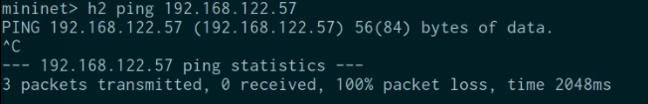
pinging ip in blocked subnet.
Blocked.

Slide 14
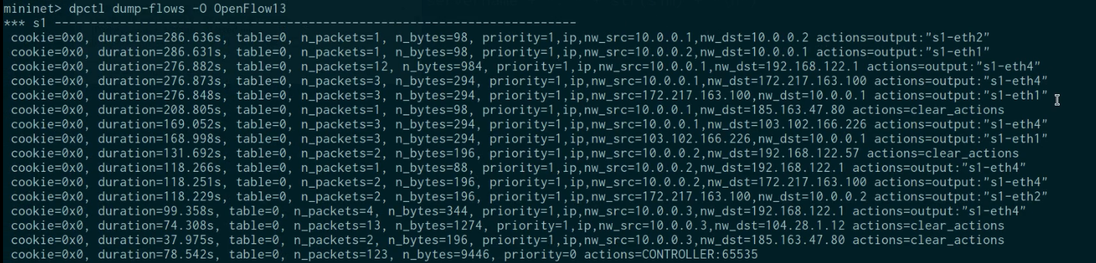
Domain name | IP | SIM
www.google.com | 172.217.163.100 | 0.616
www.thepirate-bay.org | 185.163.47.80 | 0.909
www.wikipedia.com | 103.102.166.226 | 0.682
torrentdownloads.proxybit.space | 103.28.1.2 | 0.889
SDN Flow Table
google
Clear actions for pirate bay

Slide 15
Thank You

